Slide 1

An Introduction to
Computational Thinking
Notes:
This project was supported by a grant from CIRA's Community Investment Program.

Slide 2
Inspire & Empower
Canadian Children with
CODE
We are a Canadian not for profit organization dedicated to empowering kids, teachers and parents with the skills we all need to thrive in a technology driven society.
By teaching kids how to code we teach them how
to be better thinkers and better creators in a digital world.

Slide 3
Computational thinking is
a way of thinking like critical thinking,
creative thinking and problem solving.
Notes:
Computational thinking is a way of thinking that helps us to better understand how we can use the tool called “computer”. Computers can be used to do a multitude of things: - Solve problems. - Display data in various formats (visual, audio, force-feedback) - Animations (Pixar, Disney, Dreamworks, etc….) - Create games.
Enable new ways to collaborate.
Interact with the world (real and virtual)

Slide 4
Does a computer have a brain?
Does computational thinking mean
thinking like a computer?
Notes:
Ask the question to the audience and ask people to raise their hands in they think “Yes”, “No”, “Not Sure”.
The answer is “No”. Computers do not have brains, they do what someone has told them to do: the instructions are the software running on the computer. If a computer “appears” to think, it is simply processing vast quantities of information very quickly.
So computational thinking does not mean thinking like a computer since computers don’t have brains.

Slide 5




Computational
< Planning >
< Collaborating >
< Experimenting >
< Debugging >
<PRACTICES>
Thinking
{CONCEPTS}
{ Algorithms }
{ Decomposition }
{ Pattern Recognition }
{ Abstraction }
{ Logic }
/PERSPECTIVES/
/ Expressing /
/ Understanding /
/ Connecting /
Notes:
Instructor notes Introduce this as the big picture. Three key dimensions to Computational Thinking (Brennan & Resnick, AERA 2012): computational concepts, computational practices, computational perspectives
They are concepts that you already master, whether formally or not (you may be better at some than others…which is true for everyone)
Explain it clockwise: Computational concepts put into action are Practices, and that leads to Perspectives.
Explain to teachers that even though some of these concepts might seem like a giant black-hole now, they already use and understand many of them daily as we will see in next set of slides
End on Perspectives as the reason why we would want to learn and teach computational thinking,
Concepts Concepts that designers use as they program; these concepts are common to all programming and transfer to non-programming contexts
Algorithm: a series of step-by-step instructions
Decomposition: breaking down a complex problem into simpler parts
Abstraction: keeping essential characteristics/information (from the latin abs- “away from” and “trahere” -draw)
Logic: Analyzing and predicting
Pattern Recognition: learning to identify and use similarities in order to: simply, shorten, apply similar solutions
Practices:
Practices designers develop as they program: it is the process of construction and design. Practices focus on the process of thinking and learning, moving beyond the “what” you are learning to the “how” you are learning.
Experimenting: trial and error, testing new things, having an idea and trying to see how to make it work (incremental & iterative process)
Debugging: Answering the question “Does it work the way I want it to?” If the answer is “No”, figure out why then fix it. (incremental & iterative process)
Collaboration:
Planning:
Perspectives:
Designers evolve their understanding of the technological world around them, their relationship with others, and of themselves.
Expressing = computer programming can be a means of expressing oneself because it is a tool, it can be used in many different ways (web pages, art, music, games, etc…) just like a pencil can be used to write a report or draw a picture.
Understanding = being better able to understand today’s sociotechno reality - being able to recognize and use some of the tools that create this reality
Connecting = creativity and learning are deeply social practice, facilitate being able to reach out to others in a new ways (creating with others and creating for others)

Slide 6
Concepts
Notes:
INSTRUCTOR SUMMARY ONLY (the concepts are explained on separate slides). Concepts Concepts that designers use as they program; these concepts are common to all programming and transfer to non-programming contexts
Algorithm: a series of step-by-step instructions
Decomposition: breaking down a complex problem into simpler parts
Logic: Analyzing and predicting
Pattern Recognition: learning to identify and use similarities in order to: simply, shorten, apply similar solutions
Abstraction: keeping essential characteristics/information (from the Latin “abs” - away from and “trahere” -draw)
Concepts are put into action through practices. This leads to insights and perspectives about technology that we may not have otherwise.

Slide 7


Algorithm
A series of step-by-step instructions
Notes:
What are examples of every day algorithms?
Following a recipe, brushing your teeth, getting dressed (yes you can put your socks on before your pants but underwear goes on before outerwear!), starting your car…
Other examples:
Building with clear stages: snowman
bedtime/sleep routine
Planting a seed
In a classroom, the one algorithm everyone needs to know and follow: What to do when the fire alarm sounds.
Let’s take a minute to make sure what everybody is operating from the same set of step-by-step instructions.
What’s your fire drill?

Slide 8
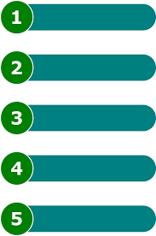
Teach the class…
Decomposition
Breaking down a
complex problem
into simpler parts
Notes:
We all do this in our everyday lives, we are simply not conscious of it. Example: “Teach the class” that is a complex problem… Question: How do you break it down into smaller parts?
Potential “simpler” parts…
Plan your day
Get to school
Go to your class at a specific time
Prepare your class/material
Take attendance
Start the class
Is there a test today? Yes – give instructions.
Etc..
Being able to break a problem down into small parts is a very important skill.
Can you think of a time recently when you broke a problem down to make it easier?
Cleaning a room one section at a time,
Making a snowman: make the pieces first and put them together
puzzles: making the edges first
murals: each person does a little part

Slide 9
Computational
< Planning >
< Collaborating >
< Experimenting >
< Debugging >
<PRACTICES>
Thinking
{CONCEPTS}
{ Algorithms }
{ Decomposition }
{ Pattern Recognition }
{ Abstraction }
{ Logic }
/PERSPECTIVES/
/ Expressing /
/ Understanding /
/ Connecting /
Notes:
Instructor notes Introduce this as the big picture. Three key dimensions to Computational Thinking (Brennan & Resnick, AERA 2012): computational concepts, computational practices, computational perspectives
They are concepts that you already master, whether formally or not (you may be better at some than others…which is true for everyone)
Explain it clockwise: Computational concepts put into action are Practices, and that leads to Perspectives.
Explain to teachers that even though some of these concepts might seem like a giant black-hole now, they already use and understand many of them daily as we will see in next set of slides
End on Perspectives as the reason why we would want to learn and teach computational thinking,
Concepts Concepts that designers use as they program; these concepts are common to all programming and transfer to non-programming contexts
Algorithm: a series of step-by-step instructions
Decomposition: breaking down a complex problem into simpler parts
Abstraction: keeping essential characteristics/information (from the latin abs- “away from” and “trahere” -draw)
Logic: Analyzing and predicting
Pattern Recognition: learning to identify and use similarities in order to: simply, shorten, apply similar solutions
Practices:
Practices designers develop as they program: it is the process of construction and design. Practices focus on the process of thinking and learning, moving beyond the “what” you are learning to the “how” you are learning.
Experimenting: trial and error, testing new things, having an idea and trying to see how to make it work (incremental & iterative process)
Debugging: Answering the question “Does it work the way I want it to?” If the answer is “No”, figure out why then fix it. (incremental & iterative process)
Collaboration:
Planning:
Perspectives:
Designers evolve their understanding of the technological world around them, their relationship with others, and of themselves.
Expressing = computer programming can be a means of expressing oneself because it is a tool, it can be used in many different ways (web pages, art, music, games, etc…) just like a pencil can be used to write a report or draw a picture.
Understanding = being better able to understand today’s sociotechno reality - being able to recognize and use some of the tools that create this reality
Connecting = creativity and learning are deeply social practice, facilitate being able to reach out to others in a new ways (creating with others and creating for others)

Slide 10

Pattern Recognition
Learning to identify
and use similarities to
Simplify,
Shorten,
Apply similar solutions
Notes:
Classic example of pattern recognition:
Vase/candlestick (cultural context) vs, two faces.
The first time you saw this, chances are you didn’t see both: someone had to point the alternative out to you.
Q. What are other examples of pattern recognition?
A. Possibilities include…
Facial Expressions!
Poetry: rhymes
Music: melodies, harmonies, chorus
Chess: how the pieces move

Slide 11


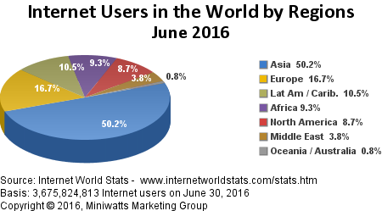
Abstraction
Reducing to a set of essential characteristics
Summarizing
Non-realistic models
Notes:
“Abstract” comes from the latin “abs-” = away from and “trahere” = draw. Abstraction is taking away/removing in order to reduce something to a set of essential characteristics (established by convention). Focus on the essentials then add to details in order to make it essential/important information more accessible/understandable: colours, shapes, textures, numbers…
What do these images have in common?
They are all non-realistic representations of things. There are established conventions so that we can communicate and recognize the representation as being the same thing. Globe: We recognize the shape right away, but what if it were red? Then what planet would we be looking at? Cat: We can all agree it is a cat, what would it take to make it a tiger? It’s already orange… Pie Chart: The data is already abstract: a column of numbers. The essential information is there, however by changing the representation, we make it easier to understand, to visualize the whole/bigger picture.
Computer animation is a very common form of computational abstraction: it is one of the ways we use programming as a means of expression.

Slide 12

Applying
Pattern Recognition
and
Abstraction
Notes:
Pattern recognition & Abstraction:
Q. What do you see?
“ 2 triangles, 3 circles”
Point out that none of the shapes mentioned are fully drawn!
Pattern recognition: We have learned to identify them by being exposed to the shapes, by practicing and by being corrected (immediate feedback)…remember how you teach a child shapes!
Abstraction: We look for certain essential characteristics…
If the title of the slide had been “classic computer games” or you grew up only looking at video games, what would you see? Pacman!

Slide 13
Computational
< Planning >
< Collaborating >
< Experimenting >
< Debugging >
<PRACTICES>
Thinking
{CONCEPTS}
{ Algorithms }
{ Decomposition }
{ Pattern Recognition }
{ Abstraction }
{ Logic }
/PERSPECTIVES/
/ Expressing /
/ Understanding /
/ Connecting /
Notes:
Instructor notes Introduce this as the big picture. Three key dimensions to Computational Thinking (Brennan & Resnick, AERA 2012): computational concepts, computational practices, computational perspectives
They are concepts that you already master, whether formally or not (you may be better at some than others…which is true for everyone)
Explain it clockwise: Computational concepts put into action are Practices, and that leads to Perspectives.
Explain to teachers that even though some of these concepts might seem like a giant black-hole now, they already use and understand many of them daily as we will see in next set of slides
End on Perspectives as the reason why we would want to learn and teach computational thinking,
Concepts Concepts that designers use as they program; these concepts are common to all programming and transfer to non-programming contexts
Algorithm: a series of step-by-step instructions
Decomposition: breaking down a complex problem into simpler parts
Abstraction: keeping essential characteristics/information (from the latin abs- “away from” and “trahere” -draw)
Logic: Analyzing and predicting
Pattern Recognition: learning to identify and use similarities in order to: simply, shorten, apply similar solutions
Practices:
Practices designers develop as they program: it is the process of construction and design. Practices focus on the process of thinking and learning, moving beyond the “what” you are learning to the “how” you are learning.
Experimenting: trial and error, testing new things, having an idea and trying to see how to make it work (incremental & iterative process)
Debugging: Answering the question “Does it work the way I want it to?” If the answer is “No”, figure out why then fix it. (incremental & iterative process)
Collaboration:
Planning:
Perspectives:
Designers evolve their understanding of the technological world around them, their relationship with others, and of themselves.
Expressing = computer programming can be a means of expressing oneself because it is a tool, it can be used in many different ways (web pages, art, music, games, etc…) just like a pencil can be used to write a report or draw a picture.
Understanding = being better able to understand today’s sociotechno reality - being able to recognize and use some of the tools that create this reality
Connecting = creativity and learning are deeply social practice, facilitate being able to reach out to others in a new ways (creating with others and creating for others)

Slide 14
Logic
Analysing and Predicting (cause & effect)
Computational thinking challenge
If today is Friday, what is the day after the day before the day before tomorrow?
Notes:
Logic is using what we know to analyze what we observe and predict what should occur: cause and effect.
Computational thinking challenge: Show the challenge and ask immediately “Is this a simple question?”

Slide 15
Applying
Decomposition,
Logic,
and
Pattern Recognition
If today is Friday, what is
the day after
the day before
the day before
tomorrow?
Notes:
What about looking at it differently? Let’s change the formatting…

Slide 16
Applying
Decomposition,
Logic,
and
Pattern Recognition
If today is Friday, what is
the day after
the day before
the day before
tomorrow?
Notes:
What about looking at it differently? We can change the formatting some more: Which do you find easier to understand: the first or the second organization of information? Why? Now let’s solve it! Let the participants work it out, Raise your hand when you’re ready…(gives everyone a bit of time) There are two ways to solve it: start with “tomorrow” and work your way up, or start from “the day after” and work your way down.
Answer: it’s today = Friday! Did you notice the pattern?
“day after + day before” and then
“day before + tomorrow” which can be substituted with “day before + day after” so these two lines cancel each other out...
Indenting allows you to see the “inside-out”, “bottom-up” possibilities more easily and is something that is widely used in computer programming languages as a way to organise the code.

Slide 17
Applying
Decomposition,
Logic,
and
Pattern Recognition
Is this a simpler problem now?
If today is Friday, what is (the day after (the day before (the day before (tomorrow)))) ?
Notes:
Now that you’ve worked through it and solved it, here’s one final way of looking at it. Let’s change the formatting slightly… Adding parentheses is a concise way of decomposing the problem, each set indicates a new line (and an indentation)… How is this useful? (go to next slide)

Slide 18
Computational thinking applied!
Decomposition
Logic
Pattern Recognition
Algorithm
If today is Friday, what is the day after the day before the day before tomorrow?
Notes:
(Computational thinking challenge: recap) Let’s recap: Is this a simple problem to solve now? Note I asked whether it was simple, not whether it was easy… You have worked through it and learned how to do it: it may not be easy but it has become simple.
Now when you are given a similar problem, you have various strategies to solve it… Write it out again on different lines or….put in the parentheses and remember that they represent new lines. So now, you can go home and figure out the problem with parentheses - that’s right practice will always help consolidate learning! What have you gained from working on this complex problem? We have improved our skills in decomposition, logic and pattern recognition and learned a new algorithm to solve the problem the next time a similar problem is encountered… Yes, all with one small and complex challenge and a little help!

Slide 19
Practices
Notes:
Practices:
Practices focus on the process of thinking and learning, moving beyond the “what” you are learning to the “how” you are learning.

Slide 20
Computational
< Planning >
< Collaborating >
< Experimenting >
< Debugging >
<PRACTICES>
Thinking
{CONCEPTS}
{ Algorithms }
{ Decomposition }
{ Pattern Recognition }
{ Abstraction }
{ Logic }
/PERSPECTIVES/
/ Expressing /
/ Understanding /
/ Connecting /
Notes:
Instructor notes Introduce this as the big picture. Three key dimensions to Computational Thinking (Brennan & Resnick, AERA 2012): computational concepts, computational practices, computational perspectives
They are concepts that you already master, whether formally or not (you may be better at some than others…which is true for everyone)
Explain it clockwise: Computational concepts put into action are Practices, and that leads to Perspectives.
Explain to teachers that even though some of these concepts might seem like a giant black-hole now, they already use and understand many of them daily as we will see in next set of slides
End on Perspectives as the reason why we would want to learn and teach computational thinking,
Concepts Concepts that designers use as they program; these concepts are common to all programming and transfer to non-programming contexts
Algorithm: a series of step-by-step instructions
Decomposition: breaking down a complex problem into simpler parts
Abstraction: keeping essential characteristics/information (from the latin abs- “away from” and “trahere” -draw)
Logic: Analyzing and predicting
Pattern Recognition: learning to identify and use similarities in order to: simply, shorten, apply similar solutions
Practices:
Practices designers develop as they program: it is the process of construction and design. Practices focus on the process of thinking and learning, moving beyond the “what” you are learning to the “how” you are learning.
Experimenting: trial and error, testing new things, having an idea and trying to see how to make it work (incremental & iterative process)
Debugging: Answering the question “Does it work the way I want it to?” If the answer is “No”, figure out why then fix it. (incremental & iterative process)
Collaboration:
Planning:
Perspectives:
Designers evolve their understanding of the technological world around them, their relationship with others, and of themselves.
Expressing = computer programming can be a means of expressing oneself because it is a tool, it can be used in many different ways (web pages, art, music, games, etc…) just like a pencil can be used to write a report or draw a picture.
Understanding = being better able to understand today’s sociotechno reality - being able to recognize and use some of the tools that create this reality
Connecting = creativity and learning are deeply social practice, facilitate being able to reach out to others in a new ways (creating with others and creating for others)

Slide 21


PRACTICES
Planning
Collaboration
Experimenting
Debugging
Notes:
Adults (and especially teachers) employ these practices all the time! What are examples of these practices in day-to-day life?
Experimenting: Cooking/Baking: improving a recipe, trying different combinations…
Collaboration: For most things in life, you collaborate with others. For example in this workshop: (to the participants) You are being quiet, listening and participating. As the instructor, I am standing, speaking clearly and answering your questions.
Planning:
We usually plan things out when tasks are complex or unfamiliar. Ex.: For instance, how did you get here today? (for workshops that are not being held in the school) It is important to have a clear idea of what you are trying to accomplish.
Debugging: We all do this without thinking, it’s known as auto-correction (we see that we’ve made a mistake, we correct it and keep on going). Say when you’re parking your car, and you need to “re-adjust” or you buttoned your shirt and missed a button.

Slide 22
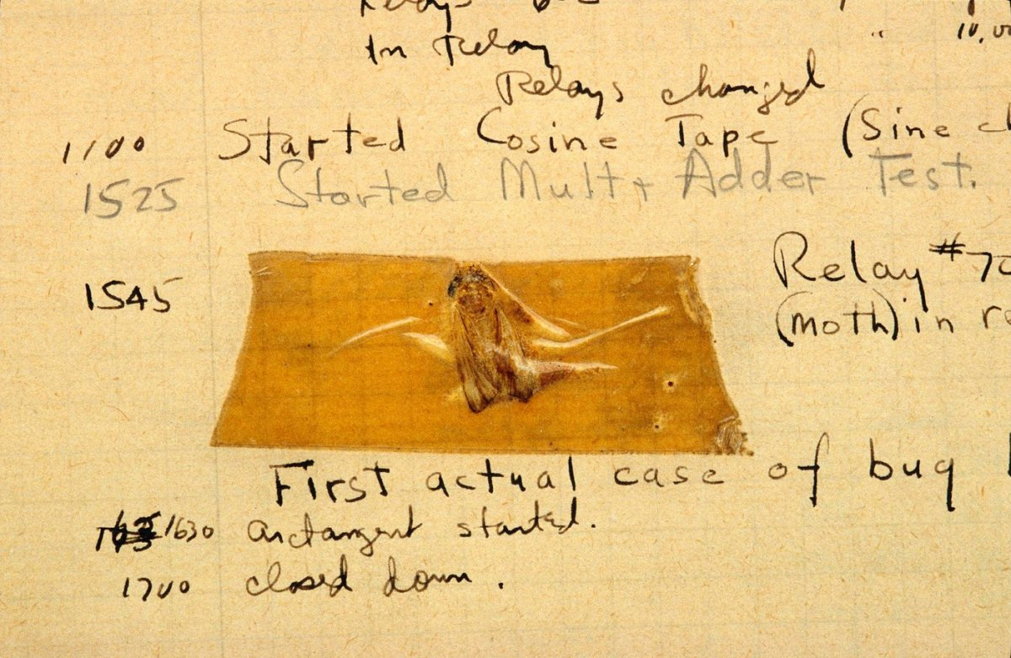
The first computer bug
DEBUGGING
Does it work the way it is suppose to? Identifying the cause and fixing it or finding a
work-around.
From Grace Hopper’s log, 1947
Notes:
Debugging: Answering the question “Does it work the way I want it to?” If the answer is “No”, figure out why then fix it. (incremental & iterative process)
Things rarely (if ever) work just as imagined, it is critical fro designers to develop strategies for dealing with - and anticipating – anticipating problems.
A little trivia:
This is the very first instance of a computer bug: a moth found in the computer - from Grace Hopper’s blog
Grace Hopper, a famous computer scientist, is credited for coining the term “debugging”. In Computer programming, debugging means getting rid of problems in the code. One of Grace Hopper’s computer glitches was actually being caused by a moth in the back of her computer! Debugging has become a very important programming technique because the more code there is, the more potential for bugs there are!
Computer programmers usually say: If your program runs perfectly the first time, ask yourself the question “Why did it work?”

Slide 23
Perspectives
Notes:
We are surrounded by technology and interactive media however, most of our experiences are as consumers.
Developing computational thinking practices and learning the concepts leads to insights and perspectives about technology.
Perspectives:
Designers evolve their understanding of the technological world around them, their relationship with others, and of themselves.
Expressing Computer programming can be a means of expressing oneself because it is a tool, it can be used in many different ways (web pages, art, music, games, etc…) just like a pencil can be used to write a report or draw a picture. “I can create” and “I can express my ideas through this new medium”
Understanding
Creating awareness to be better able to understand today’s socio-techno reality. Being able to recognize and use some of the tools that create this reality
Connecting Creativity and learning are deeply social practices. Computational thinking facilitate being able to reach out to others in a new ways: creating with others and creating for other.

Slide 24
Computational
< Planning >
< Collaborating >
< Experimenting >
< Debugging >
<PRACTICES>
Thinking
{CONCEPTS}
{ Algorithms }
{ Decomposition }
{ Pattern Recognition }
{ Abstraction }
{ Logic }
/PERSPECTIVES/
/ Expressing /
/ Understanding /
/ Connecting /
Notes:
Instructor notes Introduce this as the big picture. Three key dimensions to Computational Thinking (Brennan & Resnick, AERA 2012): computational concepts, computational practices, computational perspectives
They are concepts that you already master, whether formally or not (you may be better at some than others…which is true for everyone)
Explain it clockwise: Computational concepts put into action are Practices, and that leads to Perspectives.
Explain to teachers that even though some of these concepts might seem like a giant black-hole now, they already use and understand many of them daily as we will see in next set of slides
End on Perspectives as the reason why we would want to learn and teach computational thinking,
Concepts Concepts that designers use as they program; these concepts are common to all programming and transfer to non-programming contexts
Algorithm: a series of step-by-step instructions
Decomposition: breaking down a complex problem into simpler parts
Abstraction: keeping essential characteristics/information (from the latin abs- “away from” and “trahere” -draw)
Logic: Analyzing and predicting
Pattern Recognition: learning to identify and use similarities in order to: simply, shorten, apply similar solutions
Practices:
Practices designers develop as they program: it is the process of construction and design. Practices focus on the process of thinking and learning, moving beyond the “what” you are learning to the “how” you are learning.
Experimenting: trial and error, testing new things, having an idea and trying to see how to make it work (incremental & iterative process)
Debugging: Answering the question “Does it work the way I want it to?” If the answer is “No”, figure out why then fix it. (incremental & iterative process)
Collaboration:
Planning:
Perspectives:
Designers evolve their understanding of the technological world around them, their relationship with others, and of themselves.
Expressing = computer programming can be a means of expressing oneself because it is a tool, it can be used in many different ways (web pages, art, music, games, etc…) just like a pencil can be used to write a report or draw a picture.
Understanding = being better able to understand today’s sociotechno reality - being able to recognize and use some of the tools that create this reality
Connecting = creativity and learning are deeply social practice, facilitate being able to reach out to others in a new ways (creating with others and creating for others)

Slide 25
Perspectives
Expressing
Understanding
Connecting
Learning to code is one of the best ways
to develop computational thinking.
Notes:
Learning computer programming or “learning to code” is one of the ways that we put concepts into action (practices) and gain important insights and perspectives about how we can best use technology.
The goal of learning to code (a skill) , should be to develop computational thinking (the competence) and spark a growth in perspectives such as:
- Programming can be used as a means of expression,
- Learning to code can lead to better understanding of socio-techno reality and help us learn and negotiate those realities
- Allows us to look further to seek connections: whether it be for help, to find people who share ideas with, to communicate, etc…

Slide 26
Unplugged!
Notes:
Practices:
Practices focus on the process of thinking and learning, moving beyond the “what” you are learning to the “how” you are learning.

Slide 27
GRAPH PAPER PROGRAMMING

Slide 28
Questions? Suggestions? We’d love to hear from you. educators@kidscodejeunesse.org
www.kidscodejeunesse.org

Slide 29
Please tell us what you think!
Survey Link
Instructor’s Name educators@kidscodejeunesse.org
www.kidscodejeunesse.org

Slide 30

This project was funded by CIRA’s Community Investment Program.

Slide 31
ADDITIONAL INFORMATION & CHALLENGES

Slide 32
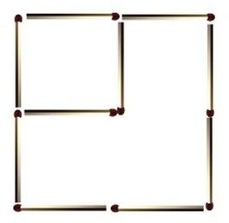
Matchstick Challenge The are 2 squares. Move only 2 matchsticks
to create 3 squares.
Notes:
Pattern recognition, logic, decomposition

Slide 33
Matchstick Challenge SOLUTION
Notes:
Pattern recognition, logic, decomposition

Slide 34
Applying
Decomposition,
Logic,
and
Pattern Recognition
Second computational thinking challenge:
Add all the numbers
from 1 to 200, in 10 seconds, in your head.
Notes:
Additional computational thinking challenge- if time permits.

Slide 35
Clearly, we need to use a different algorithm than…
1 + 2 + 3 + …. + 198 + 199 + 200
to meet the challenge’s requirements.
Can someone recognize a pattern that will help define a new algorithm?
Notes:
By adding 1 to 200 we get 201, 2 to 199 we get 201, etc. This gives us a pattern that from which we can create a simple algorithm: into a simple formula 201 x 100 (pairs).
Solving this problem uses decomposition, logic and pattern recognition. We’ve reduced a very long algorithm, into a much simpler efficient one through Computational Thinking.

Slide 36
Computational thinking
at work…
Logic
Pattern Recognition
Decomposition
Algorithm
What if we look at the problem like this…
1 + 200 = 201
2 + 199 = 201
…
100+101 = 201
Then we have 100 pairs that each add up to 201…
Notes:
If we add 1 to 200 we get 201, 2 to 199 we get 201, etc. This gives us a pattern that from which we can create a simple algorithm: into a simple formula 201 x 100 (pairs).
Solving this problem uses decomposition, logic and pattern recognition. We’ve found an efficient algorithm through Computational Thinking. We have improved our skills in decomposition, logic and pattern recognition and learned a new algorithm to solve a similar problem the next time it is encountered

